Slide 1
Strategy
Executive Sponsor
Alignment
Major
Domo
Domo
Master
Business
Data
Specialist
Technology

Slide 2
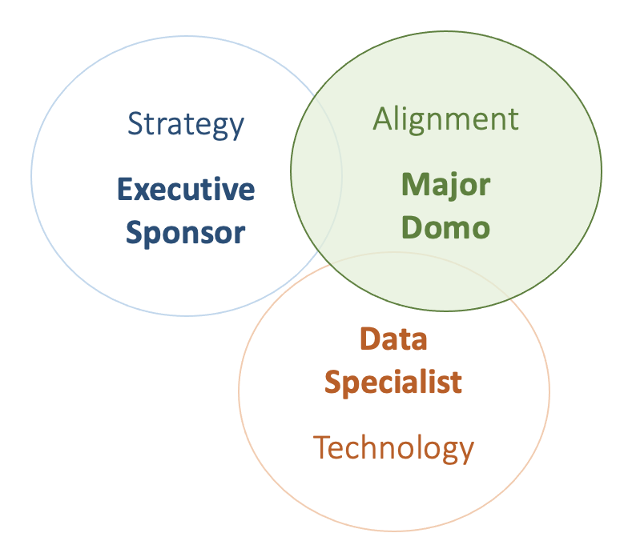

Size
People
Structure
Small
Hero
Department
Hierarchy
Enterprise
Hub & Spoke

Slide 3
One Person
Several People
One Group
Many People
Many Groups
Few People
One Group
Many People
Few Groups
GROWTH
Small
Enterprise
Hero
Hierarchy
Hub & Spoke

Slide 4
Executive Sponsor
Major Domo
CEO
CFO
Domo Master
CRO
CMO
Domo Master
COO
CIO
Domo Master
Data Specialist
Data Specialist
Data Specialist

